Slide 1
Office DEVCamp – Los Angeles
Module 2: Setting up the Environments
Registration for Los Angeles June 16 2015
http://aka.ms/O365campLA

Slide 2
Course Agenda
Office Camp
Module 1: Introduction to the Day
Module 2: Setting up the Environments
Module 3: Hooking into Apps for SharePoint
Module 4: Hooking into Office 365 APIs
Module 5: Hooking into Apps for Office
Module 6: Hooking into SharePoint APIs with Android

Slide 3
Setting up the Environments
Ivan Sanders
SharePoint MVP/MCT
ivan@dimension-si.com
@iasanders

Slide 4

Agenda
The Office 365 Environment
The Microsoft Azure Environment
App Development Overview
Notes:
What new APIs are available, in preview, in the Office 365 Platform
How to use these API’s in your platform of choice
Some sample business scenarios for leveraging these API’s
Level: Intermediate
Audience: Developer Essentials

Slide 5
The Office 365 Environment

Slide 6
Office Dev Center
Content
Samples
Documentation
Sign up for an Office 365 Developer Site
http://msdn.microsoft.com/en-us/library/office/fp179924(v=office.15).aspx
Notes:
Find how-to content, sample code, SDK and API documentation, VBA references, training, and articles for developing solutions and customizing Office applications and SharePoint products and technologies, including client applications, services, tools, and technologies such as apps for Office, apps for SharePoint, Access, Excel, Exchange, Lync, SharePoint Server, SharePoint Foundation, Skype, and Word.
Use an Office 365 Developer Site as a development and testing environment to shorten your setup time and start creating, testing, and deploying your apps for Office and SharePoint. Deploy the "Napa" Office 365 Development Tools to this preconfigured SharePoint site and you also get a head start on developing SharePoint-hosted apps, and apps for Office documents and mail items, without installing Visual Studio 2013 and Office Developer Tools for Visual Studio 2013 on your development computer. With an Office 365 Developer Site, you get an isolated app domain for SharePoint-hosted apps, preconfigured to use OAuth, so that you can use the Microsoft Azure Access Control Service (ACS) for authenticating and authorizing provider-hosted apps for SharePoint that are deployed to this site.
DevCamp must-haves · Install Visual Studio 2013 with the latest updates
· Install the Office 365 Developer Tools
· Activate a free 30-day trial Azure account here
Fees This free event is brought to you by your local Microsoft office. Delegates are responsible, however, for booking and funding their own travel and accommodation, as required.

Slide 7
Developer Site Collection
Required for remote app development
Created automatically if you sign up for an Office 365 Developer Site
Use the Developer Site template to create a new Site Collection in an existing tenancy
Notes:
An Office 365 Developer Site makes it easier to get set up and start creating, testing, and deploying your apps for Office and SharePoint more quickly. Office 365 enterprise (E3 or E4) subscriptions include a site template you can use to create a Developer Site.

Slide 8
App Catalog
Required to publish apps
Create in the SharePoint Admin Center
Apps/App Catalog
Notes:
As a SharePoint Online admin, you can create an App Catalog site to make internally developed custom apps available for users to install when they browse apps under the From Your Organization filter on the Site Contents page. Site owners can then add these apps to customize sites with specific functionality or to display information.
After an App Catalog site has been created, you can use it to upload any custom apps that your organization has developed. Uploading custom apps is not much more complicated than uploading a document to a library and setting some properties. You can also use the App Catalog site to do things like install custom or third-party apps on sites for users (also called app deployment). You can also manage app requests from users.

Slide 9
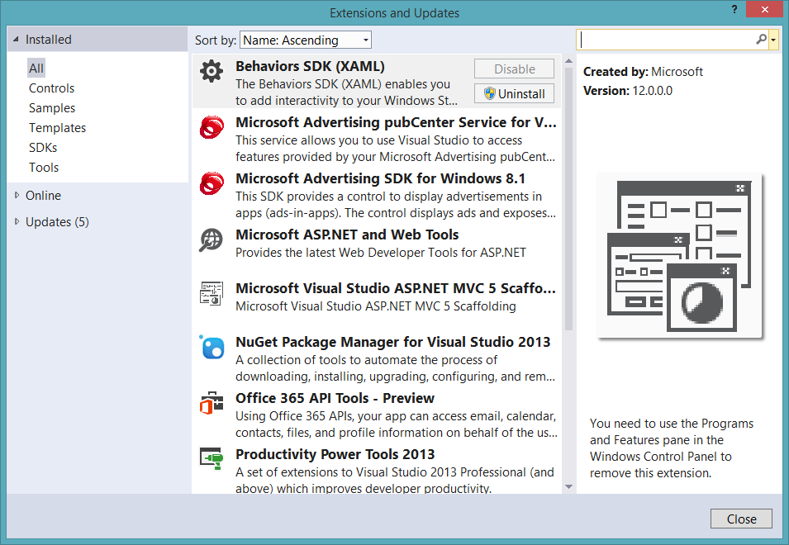
Visual Studio 2013
90-Day Trial
http://www.visualstudio.com/en-us/downloads/download-visual-studio-vs.aspx
Office 365 API Tools

Slide 10
demo
Obtaining an Office 365 Developer Subscription

Slide 11
The Microsoft Azure Environment

Slide 12
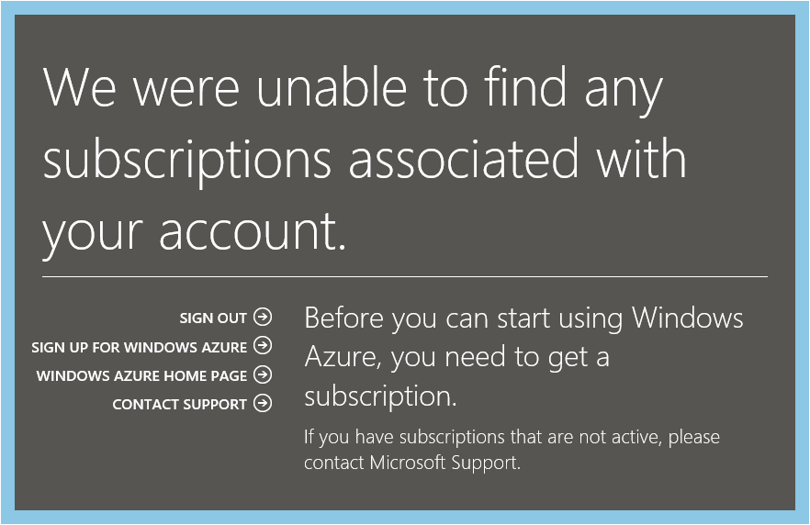
Azure Subscription
Navigate to Azure Portal using Office 365 credentials
When prompted, sign up for a trial

Slide 13
Link Office 365 and Azure
Log into Microsoft Azure subscription as administrator
Click on the Active Directory link.
Click New>Active Directory>Directory>Custom Create
Select to Add an Existing Directory
Follow the steps to add an existing directory
Notes:
It’s not required to link the Office 365 Directory to an Azure subscription for simply creating provider-hosted apps, but it makes life a bit easier and opens up the ability to call into Office 365 from other applications.

Slide 14
Office 365 Account as Azure Admin
Log into an existing Microsoft Azure as administrator
Click the Settings link
Click Administrators
Click Add
Add the Organizational Account from Office 365
Notes:
By adding an Office 365 account as an Azure administrator, you can use a single account for managing both subscriptions

Slide 15
demo
Obtaining a Windows Azure trial Subscription

Slide 16
App Development Overview

Slide 17



Office 365 development platform
Contextual apps
Robust Office 365 APIs
Flexible tools
Documents
Search
Mail
Social
Calendar
People
Notes:
Two kinds of apps :
you light up Office/Exchange/SharePoint.
You consume our services in a custom (device or web) app
Contextual apps
Rich, powerful interactive IW experiences
Do more, without leaving Excel, Outlook, PowerPoint, SharePoint
Consistent Framework everywhere that Office runs. Everywhere that people do work
Robust APIs
Big news
More for SharePoint Devs
Growing up outside SharePoint
Flexible Tools
Open-ness and choice is a core pillar
But … we just want to take away all the friction
Tools targeted to specific users
Platforms with best management, capability and scale
What does this mean. Where is the value
Breadth : more endpoints and experiences
Depth: richer APIs. More capabilities
Power:

Slide 18
Office 365 Environment
Office
Exchange Online
SharePoint Online
OneDrive for Business
Yammer
Azure Active Directory (AAD)
Notes:
SharePoint Online provides a solid business collaboration platform on which developers can build solutions quickly by using familiar development tools. In addition to in-browser customizations, SharePoint Online supports development with Microsoft SharePoint Designer 2010, Microsoft Visual Studio 2010, and Microsoft Visual Studio Team Foundation Server 2010. SharePoint Online enables you to modify sites directly and deploy code as sandboxed solutions that are run in a protected environment to safeguard the environment from poorly performing or malicious code.
SharePoint Online opens a new arena for developers to create solutions for customers who use the Office 365 service instead of maintaining on-premises servers, or for clients who want to take advantage of hybrid deployments where some data is stored behind the firewall and other data is off-loaded in the cloud.

Slide 19
Azure Active Directory
Identity and Access Management for the cloud
Can create new directories or manage existing ones in Azure subscription
Used by Office 365 for authentication
Used by Azure for user authentication and application authorization
Notes:
Azure Active Directory is a comprehensive identity and access management cloud solution. It combines core directory services, advanced identity governance, security, and application access management. Azure AD also offers developers an identity management platform to deliver access control to their applications, based on centralized policy and rules.

Slide 20
Office 365 Development Options
 | Apps for SharePoint | Apps for Office | Office 365 APIs
Word, Excel, PowerPoint |  | Task Pane App Content App
Outlook |  | Mail App | Exchange Client
SharePoint Online | SharePoint-Hosted App Cloud-Hosted App |  | SharePoint Client
OneDrive for Business |  |  | SharePoint Client
AAD |  |  | Graph Client
Yammer |  |  | Yammer Client

Slide 21
Windows Azure Environment
Azure Active Directory (AAD)
Azure Access Control Services (ACS)
Azure Web Sites

Slide 22
Azure Access Control Services
Identity and Access Management for the cloud
More generic than AAD
Supports additional providers Google, Yahoo, Facebook
Can create new namespaces in Azure subscription
Used by Office 365 for application authorization
Notes:
Windows Azure Access Control Service (ACS) is a Windows cloud-based service that provides an easy way of authenticating and authorizing users to gain access to web applications and services while allowing the features of authentication and authorization to be factored out of the application code. This facilitates application development while at the same time providing users the benefit of being able to log into multiple applications with a reduced number of authentications, and in some cases only one authentication.

Slide 23
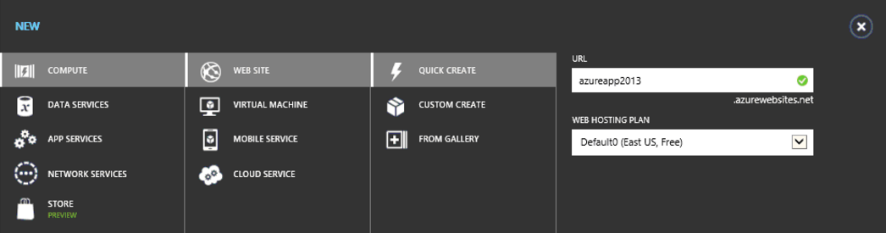
Azure Web Sites from Portal Manager

Slide 24
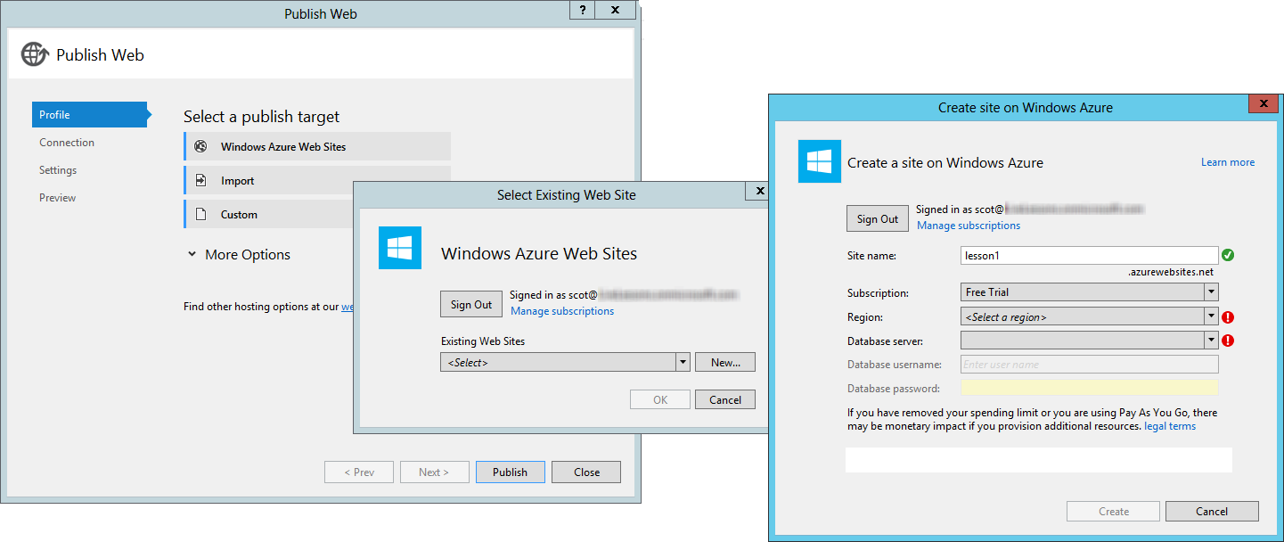
Azure Web Sites from Visual Studio

Slide 25
Office 365 and Azure
Office 365 users can be managed in Azure
Office 365 users can be Azure administrators

Slide 26
Hosting Options
 | Azure Web Site | Office 365 Site | Windows 8.1
Apps for SharePoint | Cloud-Hosted App | SharePoint-Hosted App
Apps for Office | Task Pane App Content App Mail App
Office 365 APIs | MVC 5 Web Application |  | Windows 8.1 App

Slide 27
Apps for SharePoint Dev Environment
Office 365 Developer Site Collection
Windows Azure Subscription
Visual Studio 2013
Office Developer Tools for Visual Studio 2013

Slide 28
Apps for Office Dev Environment
Office 365 Office and Exchange
Windows Azure Subscription
Visual Studio 2013
Office Developer Tools for Visual Studio 2013

Slide 29
Office 365 APIs Dev Environment
Office 365 Office and Exchange
Windows Azure Subscription
Windows 8.1
Visual Studio 2013
Office 365 API Tools

Slide 30
Summary of Key Steps
Sign up for an Office 365 subscription
Create a Developer Site Collection
Sign up for Windows Azure subscription
Link Office 365 AAD to Windows Azure
Make Office 365 user administrator in Windows Azure
Use Visual Studio remotely to develop

Slide 31
demo
Creating a Provider-Hosted App

Slide 32
Summary
The Office 365 Environment
The Windows Azure Environment
App Development Overview
Notes:
What new APIs are available, in preview, in the Office 365 Platform
How to use these API’s in your platform of choice
Some sample business scenarios for leveraging these API’s
Level: Intermediate
Audience: Developer Essentials

Slide 33

© 2012 Microsoft Corporation. All rights reserved. Microsoft, Windows, and other product names are or may be registered trademarks and/or trademarks in the U.S. and/or other countries.
The information herein is for informational purposes only and represents the current view of Microsoft Corporation as of the date of this presentation. Because Microsoft must respond to changing market conditions, it should not be interpreted to be a commitment on the part of Microsoft, and Microsoft cannot guarantee the accuracy of any information provided after the date of this presentation. MICROSOFT MAKES NO WARRANTIES, EXPRESS, IMPLIED OR STATUTORY, AS TO THE INFORMATION IN THIS PRESENTATION.

